Slide 1
GRADE 7 INTERMEDIATE LANGUAGE ARTS
MS. WRIGHT

Slide 2
WELCOME PARENTS AND CAREGIVERS!

Slide 3
OPENING PRAYER
O Lord God,
School is not always easy,
And some days, it is very difficult,
and I struggle to relax
and be at peace.
Yet I know that you will give me
patience, wisdom, and courage,
to be excellent in every way,
and you will help me love others,
as you love me.
In the name of the Father, Son and the Holy Spirit.
Amen
This is an example of a prayer we might use to start our day.

Slide 4
WHO AM I?
My name is Emily Wright and this is my service dog Kailey.
I received a Masters degree in Teaching from the University of Toronto.
I have been teaching various grades for the last several years. I also speak publicly for two speakers bureaus and work with non-profit organizations on curriculum development.
I have a special interest in social justice infused learning where students are able to talk about world issues and create personal meaning from them.
I engage students in outreach initiates, leadership opportunities and conflict resolution.
By creating their own rights, responsibilities and rules for work and play, the students in my classroom are able to be successful participants in a self-created community.

Slide 5
TEACHING BELIEFS
I strive to empower children to think deeply about their community and how their actions affect the people around them.
I believe in teaching lessons that not only follow the curriculum, but are geared towards the students developmental levels, needs, interests, and learning styles.
I place an emphasis on open-ended, real life and relevant experiences that involve cooperative learning and relate to my students’ personal lives.
I make every effort to give my students the tools and language they require to regulate their emotions, solve problems, and practice self-reflection.
I encourage children to share their personal life experiences with their peers by taking an in-depth look at specific topics of interest.
As an educator, I am committed to developing confident, independent learners who are encouraged to apply their curiosity and creativity towards solving problems and learning.

Slide 6
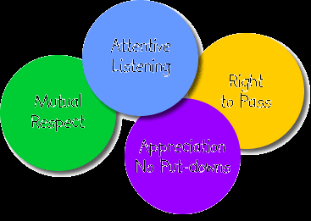
TRIBES COMMUNITY OF LEARNING
This classroom follows the Tribes approach to learning.
The following four community agreements are the basis of creating a safe environment for all learners. Care, concerns and compliments are also worked into our week as a mechanism to check-in with the class.

Slide 7
IMPORTANT ASPECTS OF THE LANGUAGE ARTS PROGRAM
Students participate in selecting their own texts
Student centred
Focuses on a big idea or question
Varied types of texts
Provide authentic experiences for students (p. 43)
Questioning while reading (p. 43)
Reflecting on what has been discovered while reading (p. 43)
Identifying the author’s purpose and point of view (p. 43)
Summarizing whole texts and passages from texts (p. 43)
Stairs, A. J., & Burgos, S. S.. The Power of Independent, Self-Selected Reading in the Middle Grades. Middle School Journal, 41.3. 2010.

Slide 8
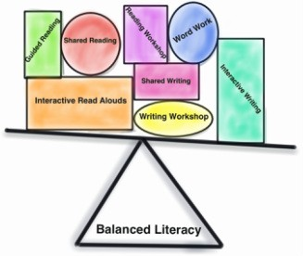
WHAT IS A BALANCED LITERACY PROGRAM?
Meeting the student at their own level and helping them move forward
Learning builds on previous experiences
Supporting all areas of learning that are important for literacy development
Making the learning meaningful and impactful to students

Slide 9
DEVELOPMENT OF ADOLESCENT LEARNERS
Emotional:
Feel emotions intensely and have strong emotional responses
May experience feelings of inadequacy
Are learning how to self-regulate and use self-control in new ways
Gain the capacity for greater empathy
Become more independent
Become more intrinsically motivated
Working memory function increases
Intellectual:
Large amounts of brain growth that lead to deeper thinking and decision making skills
Learn to take multiple perspectives
Move from concrete to argument-based thinking
Are able to think abstractly
Authentic learning that fosters inquiry is important

Slide 10
CHALLENGES IN MEETING ADOLESCENT LEARNERS NEEDS
Social:
Are creating sense of self and identity
Seek approval/acceptance from peers
Working on self-confidence
Want to fit in and belong
Testing who they are and how they want the world to see them
Developing a new sense of autonomy
Other:
Students are experiencing physical changes in their bodies which effect the way they interpret and understand the world around them.

Slide 11
TECHNOLOGY IN THE CLASSROOM
Technology is vital to this classroom because…
We live in a 21st century world that is driven by technology
Encourages collaboration and expression which fosters voice and identity
Technology connects all learning styles
Encourages digital citizenship
Engaging and motivating
Teaches students the boundaries and safety procedures that exist when using technology
Assists in analyzing the messages student receive from the media
Allows students to explore how to use social media appropriately, concisely and for a purpose
Devices are allowed in the classroom as long as they are used appropriately and with a specific learning purpose

Slide 12
COMPONENTS OF THE LITERACY PROGRAM
Critical Literacy
Interrogating texts
Who's voice is present?
Who's voice is absent?
What language is used to perpetuate stereotypical ideas?
Who tells their story? Why?
What stories are accurate on the internet? How do we know?
Supports perspective taking and greater empathy
Also supports abstract thinking and argument-based thinking
Metacognition
Reflecting on strengths and weaknesses and creating a plan or goal for improvement
Self-assessment and self-analysis
Improves student confidence
Supports growing autonomy, sense of self and identity

Slide 13
COMPONENTS OF THE LITERACY PROGRAM
Questioning
Respectful and meaningful interactions and discussions
Consolidate comprehension and inquiry thinking skills.
Questions are engaging and motivating.
Questions from students are just as important as the questions from students.
Supports testing who they are and how they want the world to see them
Supports increased self confidence
Increases self-regulation and self-control strategies.
Strategy
Activate prior knowledge and experiences
Problem Solving
Negotiating which strategy would be the best for a certain problem.
Supports abstract thinking and working memory.
Assists with students self-confidence, autonomy and independence.
Voice and Identity
Creating connections between personal, academic and social situations.
Supports self confidence, autonomy, identity and learning who they are and how they want the world to see them

Slide 14
LEARNING EXPECTATIONS OF THE GRADE 7 LANGUAGE ARTS PROGRAM
ORAL COMMUNICATION:
Listen to understand
Speak to Communicate for various purposes
Reflect and identify strengths and improvements
WRITING:
Gather and organize ideas and information
Draft and revise writing
Use editing, proofreading and publishing skills to correct errors
READING:
Construct meaning
Identify Forms and Styles
Use words and cueing systems to read fluently
Reflect and identify strengths and improvements
MEDIA LITERACY:
Understand different forms of media
Identify forms and techniques to understand meaning
Create media
Reflect on and identify strengths and improvements

Slide 15
HOW WILL YOUR CHILD BE EVALUATED?
Assessment for Learning
Informal assessment method
Provides the teacher with information on student strengths and needs so they can make adjustments
Acts as a checkpoint to see where students are, where they need to go, and how they will get there
Assessment as Learning
Is a constant form of assessment
It is differentiated depending on student needs
It involves observations, peer-assessment, self-assessment, check-lists, exit cards, graphic organizers
Assessment of Learning
helps the teacher reflect on how effective their instruction was
Used to assign a value to the quality of work presented
Quality is marked through established criteria that students and teachers are co-creators of
It involves observation, questions, small group conversations, homework tasks, rubrics, checklists and reflections.
Students will be active participants in co-created success criteria and he development of assignments.

Slide 16
OVERVIEW OF THE YEAR IN GRADE 7
TERMS: | SEPTEMBER TO DECEMBER (ONE) | JANUARY TO JUNE (TWO)
READING | Poetry Article of the Week Picture Books Topic of Interest | Graphic Novels Article of the week Autobiographical Texts Literature Circles
ORAL COMMUNICATION | Listening Skills Book Talks Speeches | Speaking Skills Presentation Skills Debates
MEDIA LITERACY | Advertising Media Messages Media Forms Current Events | Purpose and Audience Hot Topics Is Social Media ‘News’? Twitter Campaigning
WRITING | Organizing/Generating Ideas Creative Writing Poetry Speech Writing Creating Picture Books | Proofreading and Editing Autobiographical Writing Debate Writing Writers Workshop Self-Directed Writing

Slide 17
A WEEK IN THE LIFE OF GRADE 7 LANGUAGE ARTS
MONDAY | Review of Success Criteria/Big Idea Cares, Concerns and Compliments Article of the Week Discussion or Reflection
TUESDAY | Self-Selected Reading Pre-Selected Reading Reading Journal Entry/Questions
WEDNESDAY | Creative Writing Writing with Purpose Writer’s Workshop
THURSDAY | Literature Circles Book Talks and Oral Presentations
FRIDAY | Exploring Media Literacy Student Led Conferences Self-Assessment of Learning

Slide 18
HOW DO I TEACH TO MEET INDIVIDUAL STUDENT NEEDS?
Set learning objectives that are clear and specific
Connect students personal experiences and values to the learning objectives
Provide a safe and supportive learning environment
Provide an environment where students can see themselves represented
Provide meaningful material and texts that are relevant and interesting to students
Allow students to select their own texts and materials
Integrate student voice and identity into lessons and discussions
Lessons will be based on students interests and learning styles
Students will be co-creators of the assignments they complete
Self-reflection will be an active part of our classroom community
Equity is at the core of the classroom
Differentiated learning opportunities are available to meet all student needs

Slide 19
WHAT IS DIFFERENTIATED INSTRUCTION?

Slide 20
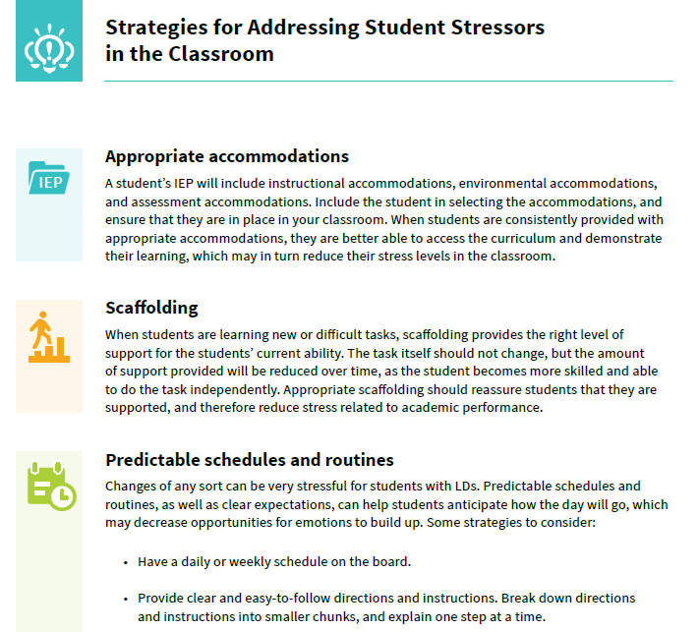
ACCOMMODATIONS AND MODIFICATIONS
I AM A BELIEVER IN ACCOMMODATIONS AND MODIFACATIOSN HERE ARE JUST A FEW EXAMPLES OF ACCOMODATIONS THAT ASSIST STUDENTS. PLEASE SET UP A TIME WITH ME TO DISCUSS YOUR CHILD’S SPECIFIC CASE.

Slide 21
I PROMISE TO…
Foster a commitment to equity of outcomes and to closing achievement gaps between students;
Use inclusive and respectful language and approaches in all interactions with students and parents;
Demonstrate a belief that all students can learn and a commitment to meeting the needs of all students in diverse ways;
Provide classroom materials and activities that engage students and represent the diversity, values, backgrounds, and experiences of students;
Communicate and work effectively with a diverse range of parents;
Model the equity and inclusive education values and vision of the school;
Use “teachable moments” to address non-inclusive, disrespectful, or discriminatory classroom behaviours;
Encourage student leadership by involving students in establishing and monitoring guidelines for achieving inclusive and accepting classrooms;
Understand that equity and inclusive education principles apply to every student and not just to certain groups of students; and,
Assume responsibility for examining and taking steps to modify personal beliefs and biases that are inconsistent with equity and inclusive education principles
(Equity and Inclusive Education in Ontario Schools, 2014, p. 55-56)

Slide 22
HOW CAN YOU HELP AT HOME?
Ask questions that go beyond yes and no.
Have purposeful conversations with your children.
Engage in discussions about current events.
Ask children to identify the various voices, power dynamics, stereotypes, and new learning they gain from the texts they read.
Encourage children to use their voice and identity when selecting texts.
Model the importance of reading and writing at home.
Provide access to meaningful text and writing opportunities.

Slide 23
QUESTIONS ??

Slide 24
FAMILY RESOURCES
Indigenous Education https://www.tcdsb.org/ProgramsServices/SchoolProgramsK12/FirstNationsMetisAndInuit/Pages/default.aspx
English Language Learners https://www.tcdsb.org/ProgramsServices/SchoolProgramsK12/ESL/Pages/default.aspx
Equity and Inclusive Education https://www.tcdsb.org/Board/EIE/Pages/default.aspx
21st Century Learning https://www.tcdsb.org/ProgramsServices/SchoolProgramsK12/AcademicICT/Pages/default.aspx
Catholic Education at the TCDSB https://www.tcdsb.org/ProgramsServices/CatholicEducation/Pages/default.aspx
Curriculum Leadership and Innovation https://www.tcdsb.org/ProgramsServices/SchoolProgramsK12/Pages/Default.aspx
Assessment and Testing https://www.tcdsb.org/ProgramsServices/Pages/Assessment-and-Testing.aspx
Tribes Learning Community https://tribes.com/
The Ontario Language Curriculum http://www.edu.gov.on.ca/eng/curriculum/elementary/language18currb.pdf
Toronto Public Library https://www.torontopubliclibrary.ca/
Assembly of Catholic Bishops http://acbo.on.ca/
Institute for Catholic Education https://iceont.ca/
Archdiocese of Toronto https://www.archtoronto.org/
St. Agnes Catholic School https://www.tcdsb.org/schools/stagnes/Pages/default.aspx
Blessed Trinity Parish https://blessedtrinityto.archtoronto.org/

Slide 25
CLOSING PRAYER
This is an example of a prayer we might use to end our day.
Dear God,
I give thanks for all the amazing gifts You have blessed me with in this life. Thank You
for the clouds in the sky and the grass beneath my feet.
Thank You for the roof over my head that shelters me from the cold and the food in
my stomach that nourishes my body.
Thank You for the clothes on my back and the knowledge in my head. Most of all,
God, thank You for Your everlasting love, guidance and understanding.
In the name of the Father, Son and the Holy Spirit.
Amen

Slide 26
THANK YOU !!

