Slide 1
Remembrance day Day 1

Slide 2
“THE PEACE BOOK” BY TODD PARR EXPECTATION: LISTEN ATTENTIVELY TO THE BOOK

Slide 3
BIG IDEA: TO PUT TOGETHER A REMEMBRANCE DAY ASSEMBLY ABOUT PEACE. EXPECTATION: TO RECITE A PAGE OF “THE PEACE BOOK” DURING THE ASSEMBLY.

Slide 4
TASKS: HAND OUT SCRIPTS. DIVIDE UP PAGES OF THE BOOK. STUDENTS WILL WRITE THEIR NAME BESIDE THE PAGE THEY WILL READ. PRACTICE.

Slide 5
Remembrance day day 2

Slide 6
READ “WHAT DOES PEACE FEEL LIKE?” BY VLADIMIR RODUNSKY

Slide 8
PRACTICE OUR SCRIPT FOR THE ASSEMBLY

Slide 9
Remembrance day day 3

Slide 10
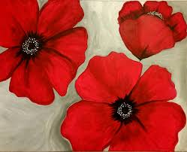
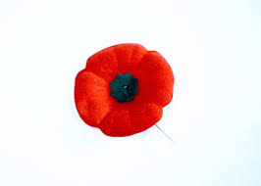
WHY DO WE WEAR THE POPPY IN NOVEMBER?

Slide 11
“A POPPY IS TO REMEMBER” BY HEATHER PATTERSON AND RON LIGHTBURN

Slide 12
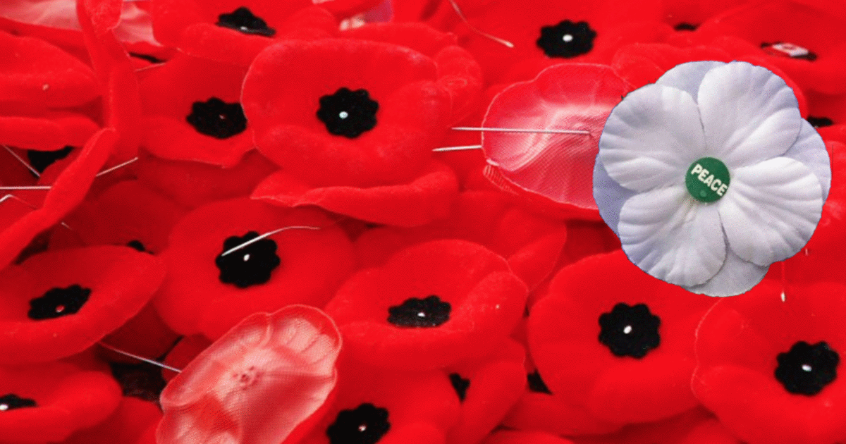
BIG IDEA: HOW DOES A POPPY RELATE TO THE IDEA OF PEACE?

Slide 13
EXPECTATIONS: 1. WRITE WHAT PEACE FEELS LIKE TO YOU ON THE POPPY USING BLACK PERMENANT MARKERS. 2. YOUR POPPIES WILL BE USED AS A DISPLAY FOR THE ASSEMBLY SO DO YOUR BEST WORK.

Slide 14
PRACTICE FOR ASSEMBLY

Slide 15
Remembrance day day 4

Slide 16
WHAT DOES PEACE MEAN TO YOU?

Slide 17
MILL TO MUSIC. WHEN THE MUSIC STOPS GET IN A GROUP OF THREE AND SHARE WHAT PEACE MEANS TO YOU.

Slide 18
“PEACE” BY WENDY ANDERSON HALPERIN
EXPECTATION: TO LISTEN ATTENTIVELY TO THE STORY.

Slide 19
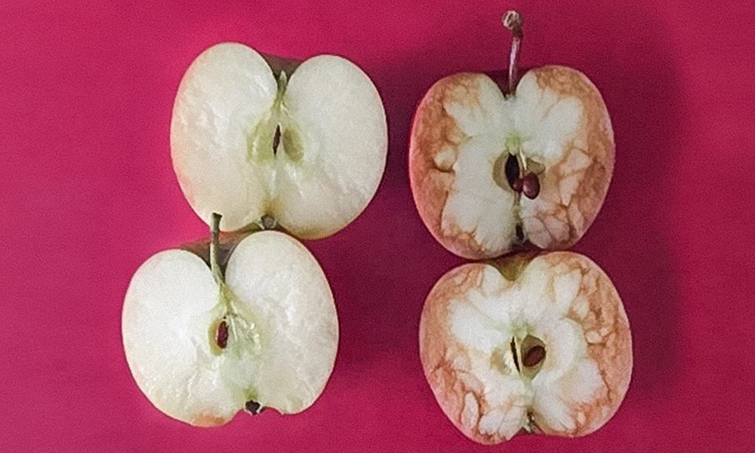
WE HAVE SPENT A LOT OF TIME THIS WEEK SPEAKING ABOUT BULLYING AND PEACE. THIS AFTERNOON I WANT TO CHALLENGE YOU TO MAKE CONNECTIONS BETWEEN BOTH OF THESE TOPICS. .

Slide 20
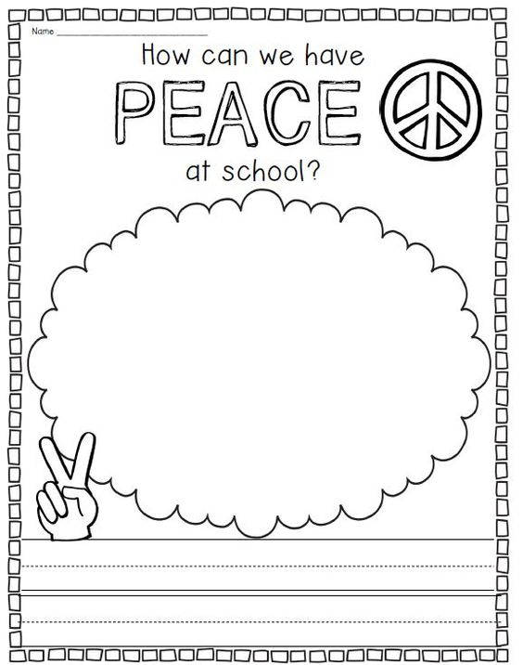
BIG IDEA: HOW CAN WE HAVE PEACE AT SCHOOL? EXPECTATION: COMPLETE THE WORKSHEET. BE PREPARED TO SHARE YOUR LEARNING WITH THE CLASS.

Slide 21
SHARE YOUR LEARNING

Slide 22
PRACTICE FOR ASSEMBLY

Slide 23
Remembrance day assembly

Slide 24
PLEASE STAND AND JOIN US IN SINGING “OH CANADA”

Slide 26
LET’S HAVE ONE MINUTE OF SILENCE AS WE REMEMBER THOSE WHO FOUGHT SO WE COULD LIVE IN PEACE

Slide 27
“THE PEACE BOOK” BY TODD PARR

Slide 29
“BE AT PEACE WITH YOUR OWN SOUL, THEN HEAVEN AND EARTH WILL BE AT PEACE WITH YOU.”–SAINT JEROME

Slide 31
THANK YOU!!

