Slide 1
CONTOUR WIRE SELF PORTRAITS DAY 1

Slide 2
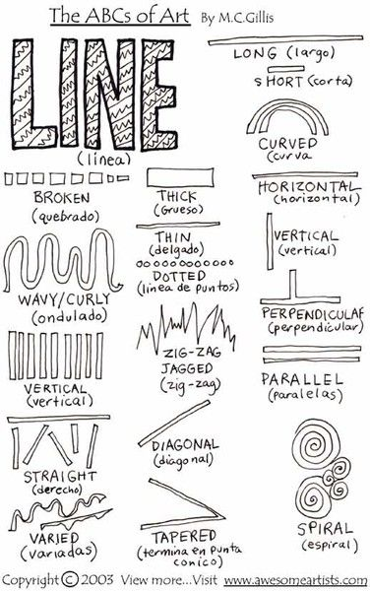
TYPES OF LINES

Slide 3
WHAT IS A SELF PORTRAIT?

Slide 4
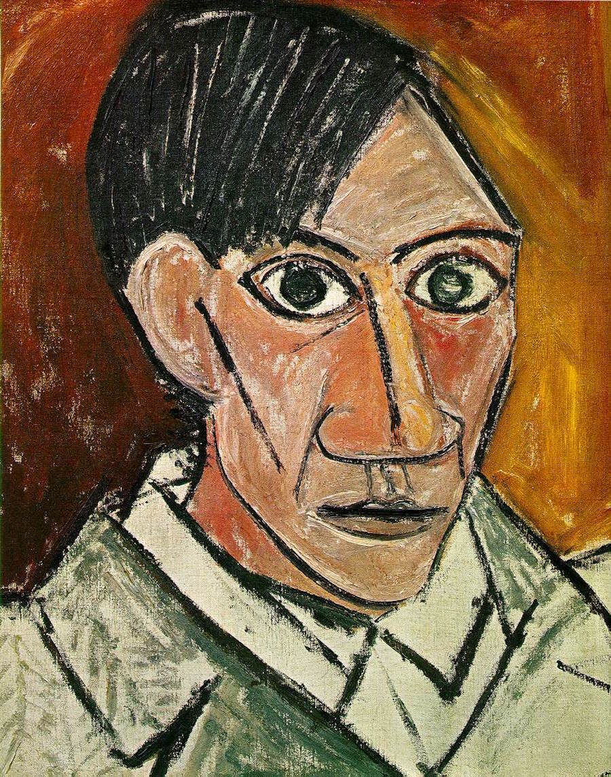
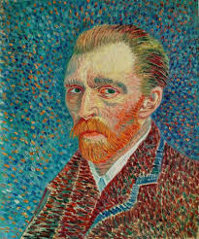
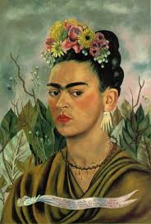

Slide 5
CONTOUR Definition: An outline, especially one representing or bounding the shape or form of something.

Slide 6
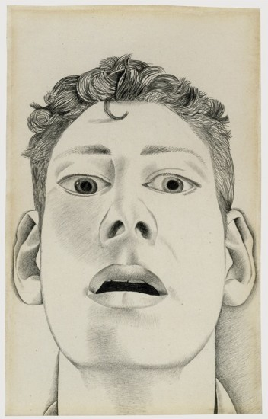
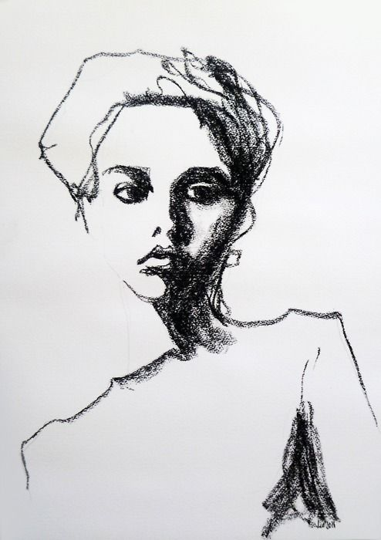
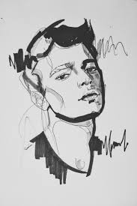

Slide 7
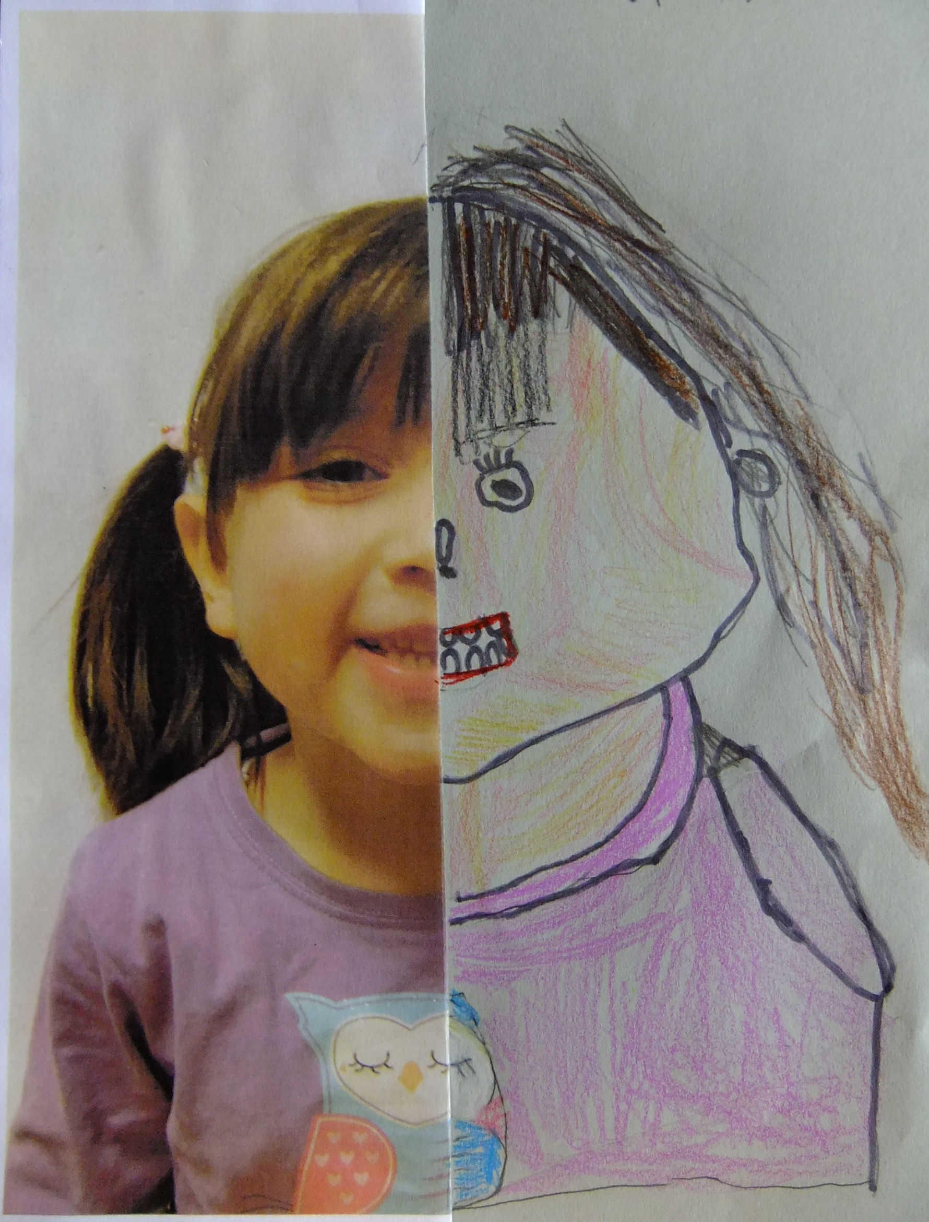
LOOK IN THE MIRROR AND DRAW YOUR OWN SELF PORTRAIT USING CHARCOAL

Slide 8
CONTOUR WIRE SELF PORTRAITS DAY 2

Slide 9
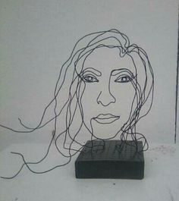
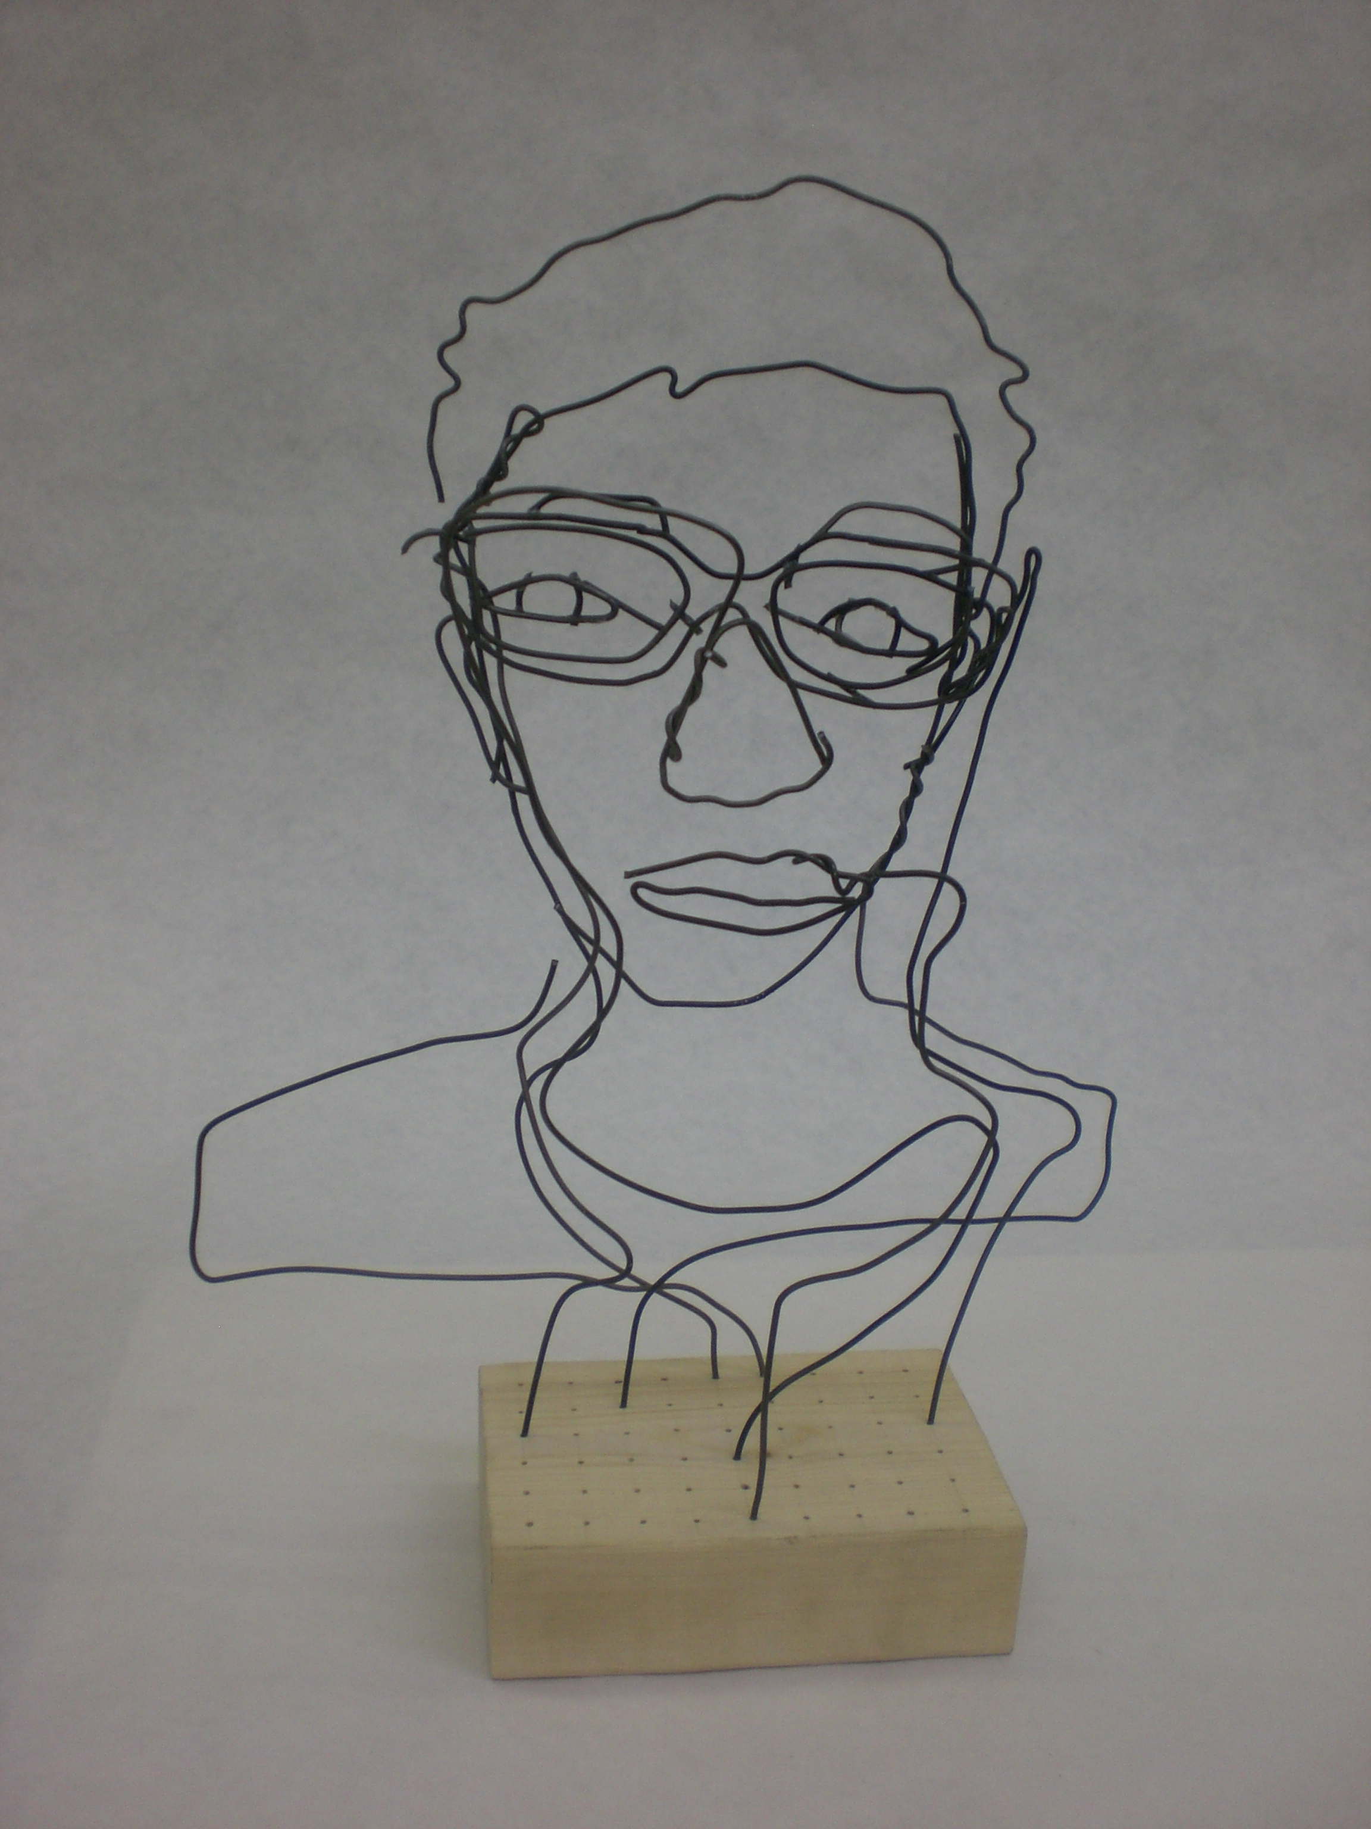
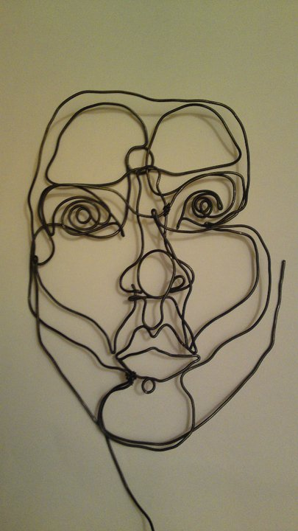

Slide 10
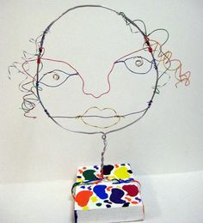
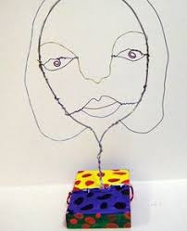
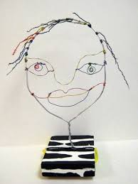

Slide 11
WHAT TECHNIQUES DO YOU THINK THESE ARTISTS USE TO SHAPE THE WIRE?

Slide 13
DIFFERENT WIRE TECHNIQUES

Slide 14
CONTOUR WIRE SELF PORTRAITS DAY 3

Slide 15
START WIRE SELF PORTRAIT Use charcoal sketch to translate into a 3D wire sculpture

Slide 16
CONTOUR WIRE SELF PORTRAITS DAY 4

Slide 17
FINISH WIRE SELF PORTRAIT

Slide 18
CONTOUR WIRE SELF PORTRAITS DAY 5 (Monday)

Slide 19
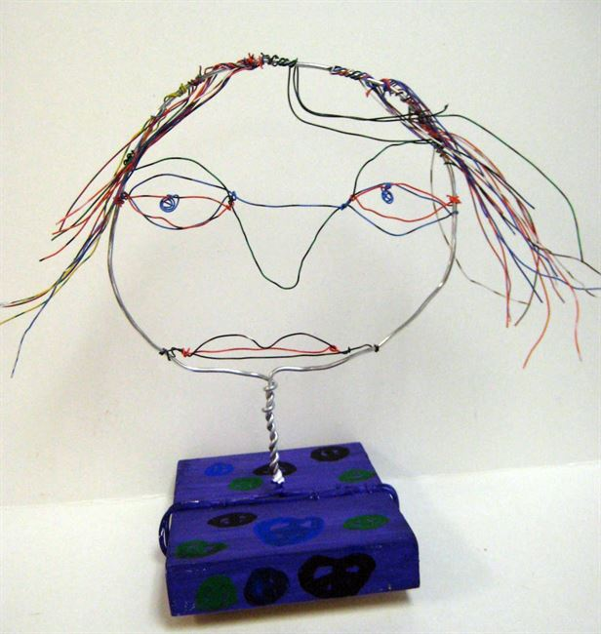
PARTICIPATE IN A GALLERY WALK TO SEE YOUR PEERS SCULPTURES

Slide 20
Each of your names will be written on a paper plate. The plate will be passed around the classroom so each of your peers can add their own positive feedback about your sculpture after the Gallery Walk.

